Slide 1


Stoney Creek Little League
Umpires Clinic 2023

Slide 2
The Rules
It is impossible for us to teach you all of the rules during this clinic. It is your responsibility to learn the rules.
1.00 is basically all of the equipment rules, the diamond dimensions, the uniforms, as well as safety rules.
2.00 is definitions. The most boring part of the book. Also the most important.
3.00 pre-game activities as well as substitutions and field decorum.
4.00 scoring, doubleheaders, field decorum, protests and forfeits.
5.00 dead ball/live ball situations.
6.00 is about the batter. When a batter is safe, when they are out, and batting out of turn.
7.00 is about the runner. Base awards, interference and obstruction.
8.00 is about the pitcher.
9.00 is all about the umpire. Where their authority comes from and what their authority is.
Tournament rules & guidelines.
Notes:
2
0:00 to 0:05

Slide 3

Little League University is a tremendous FREE and ACCURATE resource for umpiring and more.
Visit https://www.littleleague.org/university/ for more information.
Some of this content is direct from this site.
Click on the button throughout
to link to LLU articles and videos.
Notes:
0:05 to 0:08

Slide 4
OTHER USEFULL WEBSITES AND APPLICATIONS
Little League Umpire Registry:
https://www.littleleague.org/umpires/umpire-registry/
Little League Rulebook Website:
https://www.littleleague.org/playing-rules/rules-regulations-policies/
Little League Rulebook Mobile App – Available on the Apple Store or Google Play

Slide 5
Rule 1.00
OBJECTIVES OF THE GAME
NO on-deck batter ANYWHERE
NO metal spikes can be worn including coaches and umpires
NO Jewelry at all except for Medic-Alert
NO casts are allowed
The catcher MUST wear a catcher’s mitt (decker), a long or short model chest protector, shin guards, cup, helmet, mask, and dangling throat guard
The pitchers glove may not, exclusive of the piping, be white or light grey, nor, in the judgment of the umpire distracting in any manner
No pitcher may wear sweat bands on their wrists or forearms
Pitchers may wear a batting glove under their glove so long as it is not white, gray, or optic yellow
Notes:
0:25 total 0:27
No casts includes base coaches and spotters.
What do you do with a left-handed catcher?
Demonstrate the importance of the dangling throat guard.

Slide 6
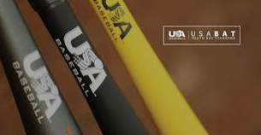
Rule 1.10 (Baseball Only) BATS
 | MINOR & MAJOR | INTERMEDIATE & JUNIOR | SENIOR
Maximum Length | 33 inches | 34 inches | 36 inches
Maximum Diameter | 2 5/8 inches | 2 5/8 inches | 2 5/8 inches
Performance Factor Mandatory Markings (Non-wood bats only) | USA BASEBALL | USA BASEBALL | -3 & BBCOR
Wood Bat Grip NO PINE TAR ALLOWED | 16 inches Optional | 18 inches Optional | 18 inches Optional
Non-Wood Bat Grip | 10 inches Mandatory | 10 inches Mandatory | 10 inches Mandatory
Notes:
0:27 to 0:28

Slide 7
Rule 2.00
Definitions
“Definitions” is not the most exciting rule to review, but it is one of the most important. We will review several definitions today.
NOTE - These are not all the definitions in section 2. For more, see the Little League Rule Book
Bunt | Force Play
Catch/Fly Ball | Infield Fly
In Flight | Interference
Catch | Obstruction
Fair Ball/Territory | Pitch
Foul Ball/Territory | Tag
Foul Tip | Strike Zone
Notes:
0:01 total 0:29

Slide 8
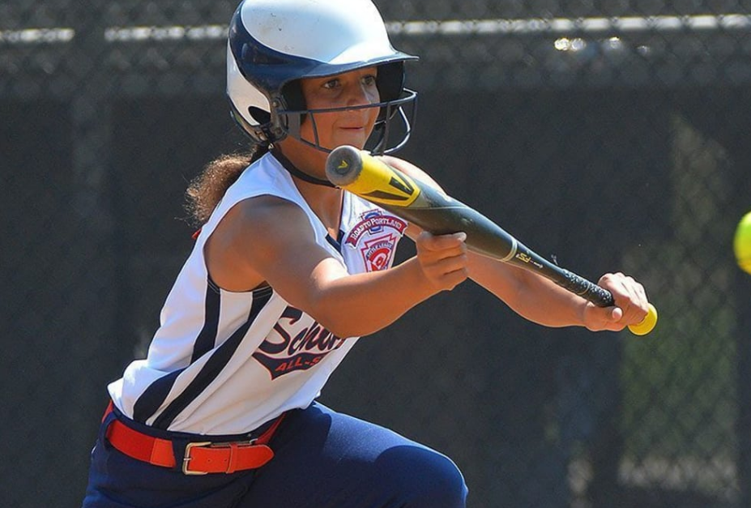
BUNT - 2.00
A BUNT IS A BATTED BALL NOT SWUNG AT, BUT INTENTIONALLY MET BY THE BAT AND TAPPED SLOWLY TO PREVENT THE BALL FROM GOING FAR. THE MERE HOLDING OF THE BAT IN THE STRIKE ZONE IS NOT AN ATTEMPTED BUNT.
Notes:
0:02 total 0:31
Key....."Intentionally met by the bat"
If the batter holds the bat in the strike zone and the pitch is not in the strike
zone, as long as the batter does not try to "intentionally" meet the ball it is a
ball. If he/she makes any motion toward the ball call it a strike.

Slide 9
IN FLIGHT - 2.00
Describes a batted, thrown, or pitched ball which has not yet touched the ground or some object other than a fielder. If the pitch touches the ground and bounces through the strike zone, without being struck at by the batter, it is a ‘ball’. If such a pitch touches the batter, the batter shall be awarded 1st base…
Notes:
0:02 total 0:33

Slide 10
CATCH - 2.00
SECURE
POSSESSION
(in hand or glove)
COMPLETE
CONTROL OF
THE BALL
VOLUNTARY
RELEASE
CATCH IF FIELDER DROPS BALL IN THE ACT OF THROWING
NO CATCH IF FIELDER DROPS BALL AS A
RESULT OF COLLISION OR FALLING
NO CATCH IF BALL TOUCHES OFFENSIVE PLAYER,
OR GROUND, FENCE OR UMPIRES
Notes:
0:04 total 0:37
Talk about:
1. Secure possession in hand or glove
2. Complete control of the ball in the hand or glove
3. Voluntary release of the ball from the hand or glove
cover the other circles as well.
Be prepared to talk about the trap against the body with the arm, etc.
Voluntary release usually comes up also.
When can a runner leave a base for the purposes of tagging up?

Slide 11
FAIR/FOUL BALL - 2.00
Batted ball that:
(a) Settles
(b) Is Touched
(c) Judged by the position of the ball
There are no foreign objects in fair territory, only in foul.
Notes:
0:02 total 0:39
A FAIR BALL is a batted ball that settles on fair ground between home and first base, or between home and third base, or that is on or over fair territory when bounding to the outfield past first or third base, or that touches first, second or third base, or that first falls on fair territory on or beyond first base or third base, or that, while on or over fair territory touches the person of an umpire or player, or that, while over fair territory, passes out of the playing field in flight. NOTE: A fair fly shall be judged according to the relative position of the ball and the foul line, including the foul pole, and not as to whether the fielder is on fair or foul territory at the time he touches the ball.
“Official Baseball Rules” Case Book Comment: If a fly ball lands in the infield between home and first base, or home and third base, and then bounces to foul territory without touching a player or umpire and before passing first or third base, it is a foul ball; or if the ball settles on foul territory or is touched by a player on foul territory, it is a foul ball. If a fly ball lands on or beyond first or third base and then bounces to foul territory, it is a fair hit.
Comment:
1) A batted ball that settles on home plate is a fair ball.
2) There are no foreign objects in fair territory, only in foul.
Key Words: Must be touched or settle in fair territory.
A FOUL BALL is a batted ball that settles on foul territory between home and first base, or between home and third base, or that bounds past first or third base on or over foul territory, or that first falls on foul territory beyond first or third base, or that, while on or over foul territory, touches the person of an umpire or player, or any object foreign to the natural ground. A foul fly shall be judged according to the relative position of the ball and the foul line, including the foul pole, and not as to whether the infielder is on foul or fair territory at the time he touches the ball.
“Official Baseball Rules” Case Book Comment: A batted ball not touched by a fielder, which hits the pitcher’s rubber and rebounds into foul territory, between home and first, or between home and third base is a foul ball.
Comments:
1) The above situation is correct for a ball on the ground. Once you make a call of “Foul Ball” when the ball is on the ground, it is foul forever. However, if the ball is in the air, it may still be caught for an out and the ball would remain alive and in play.
2) There is nothing in this rule to suggest that the batted ball must travel higher than the batter’s head to be an out. If not a foul tip or a rebound (See Rule 2.00-Foul Tip), the ball is a foul ball and can be caught for an out.
3) On a caught fly ball in foul territory, runners may legally tag up and advance.

Slide 12
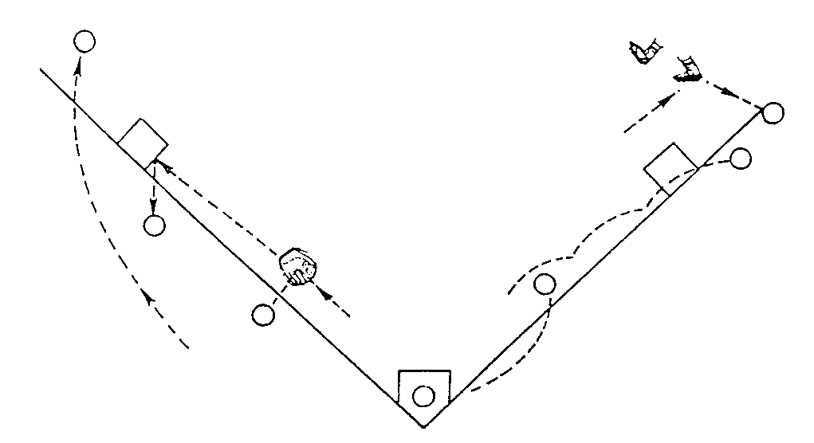
FIRST
TOUCHED
BEYOND
THE
BASE
FAIR BALL
BEFORE
A
BASE
HOME
PLATE
Notes:
0:04 total 0:40
Use this slide to demonstrate various scenarios.
Position of the ball is critical. Where the fielder is standing is not important.

Slide 13
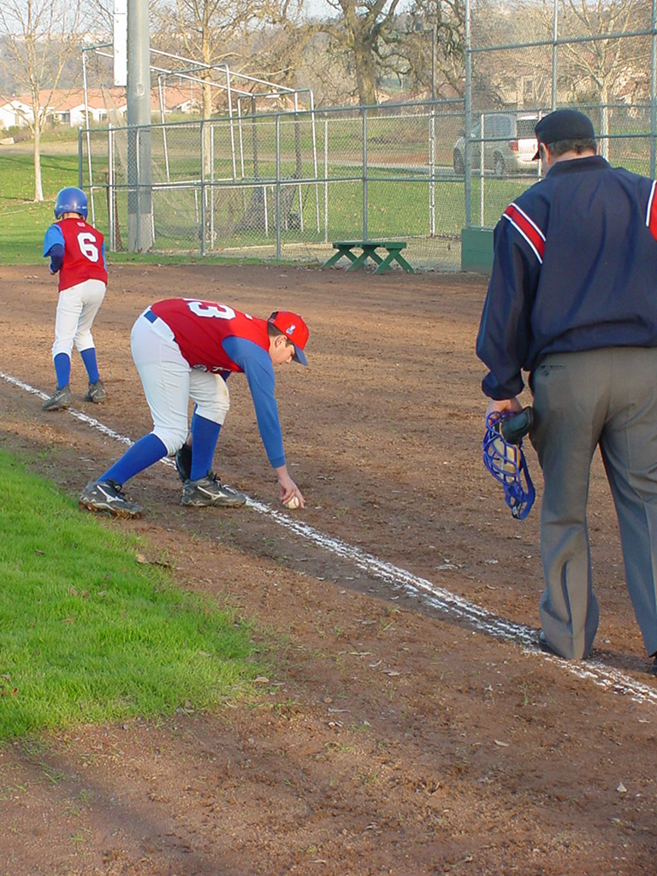
Fair or Foul?
Is Touched
Judged by the position
of the ball.
Notes:
0:01 total 0:38
Well........what do you think? Fair or Foul?
Foul.
The ball is in foul territory when the ball is first touched.

Slide 14
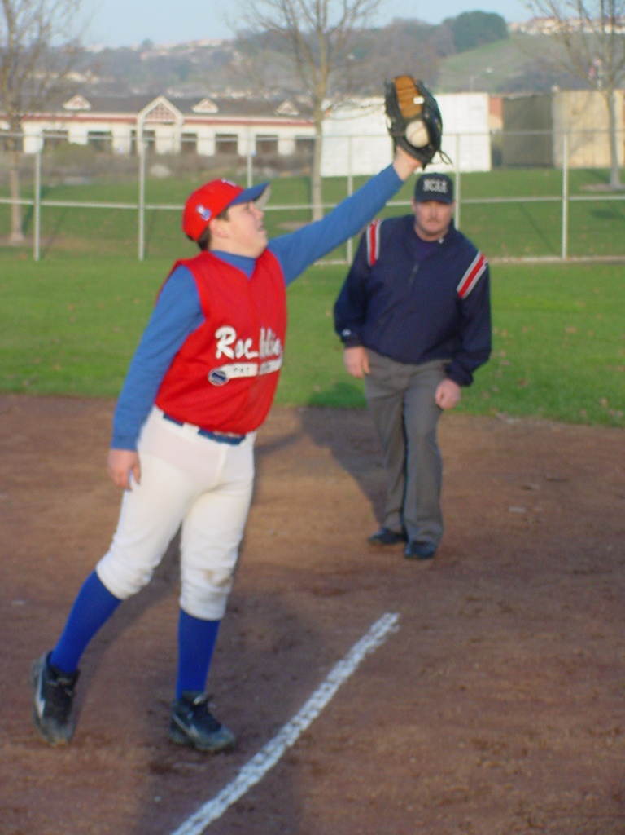
Line drive situation
Fair or Foul?
Is Touched
Judged by the position of the ball
First responsibility in this situation is to name it when it is touched…then determine catch/no catch
Notes:
0:01 total 0:39
Fair or Foul?
Assuming this is a line drive. This is a foul ball.
The first call should be to name fair or foul. The. Catch or no catch

Slide 15
FOUL TIP - 2.00
SHARP AND DIRECT
FROM BAT TO CATCHERS
HAND OR MITT
MUST BE CAUGHT
BY CATCHER
IS A STRIKE
BALL REMAINS
ALIVE
RUNNERS ARE
IN JEOPARDY
NOT A CATCH IF REBOUNDED
UNLESS IT FIRST HITS
CATCHER’S HAND OR MITT
Notes:
0:03 total 0:42
Remind them that the "BALL REMAINS ALIVE"
and runners are in jeopardy.

Slide 16
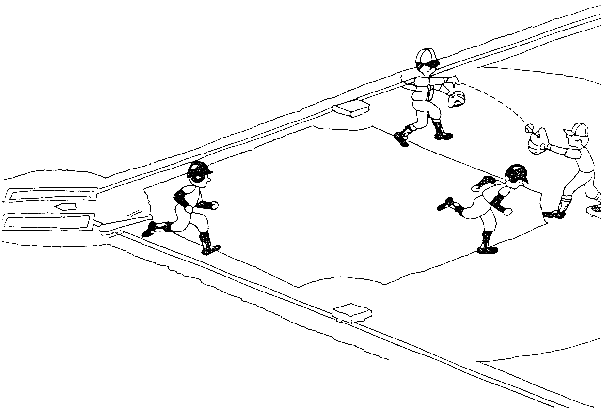
FORCE PLAY- 2.00
A force play occurs when A runner legally loses the right to occupy a base by reason of the batter becoming A runner.
Notes:
0:04 total 0:46
The class must understand what makes a force play.
If the batter is not out, you have a force play.
The batter is out, you do NOT have a force play.
WHY IS IT IMPORTANT TO KNOW WHEN THERE IS A FORCE PLAY?
So you don’t look stupid
Tell them they will have to know this to decide if a run
scores or not.
Infield Fly

Slide 17
INFIELD FLY - 2.00
Can be caught by any fielder
Batter is OUT
Force play is eliminated for all other runners
Runners must still tag up if the ball is caught
Bases protect runners hit by an infield fly
Fair fly ball
NOT a bunt or line drive
Catchable with ORDINARY effort by an infielder
Less than 2 out
R1 & R2 or R1, R2, & R3 --- Force at 3rd
Notes:
0:08 total 1:20
In judging “ordinary effort” by an infielder, an umpire (any umpire) must evaluate the relative age group of the players, not the individual ability of the respective player. “Ordinary effort” will change from division to division.
Whether the ball is an infield fly or not is solely the judgment of the umpire and may not be protested. However, if the umpires forget to call the Infield Fly because of absent-mindedness the situation must be corrected. The defense must not be allowed to get a double play when the Infield Fly should have been called. Make the belated call and get the situation corrected the way the rule was intended.
Generally, the Infield Fly is first called by the plate umpire if the infielder is moving in; in cases where the ball is even with the infielder or the infielder is moving back, the base umpire can initiate the call.
When one umpire calls “Infield Fly,” all umpires working the game call it.
There cannot be an Infield Fly on a bunt or a line drive, regardless if the other criteria have been met.
When an infield fly is called, runners may advance at their own risk. If on an infield fly rule, the infielder intentionally drops a fair ball, the ball remains in play despite the provisions of Rule 6.05(k). The infield fly rule takes precedence.

Slide 18
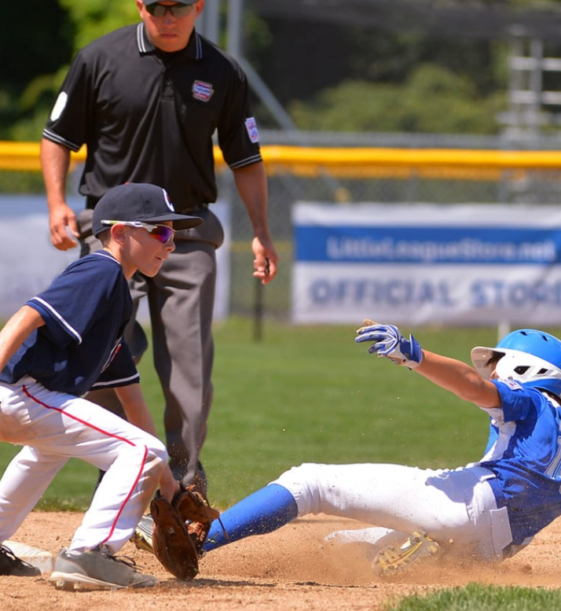
TAG - 2.00
A tag is the action of a fielder in touching a base with the body while holding the ball securely and firmly in the hand or glove;
Or touching a runner with thehand or glove holding the ball, while holding the ball securely and firmly in the hand or glove.
Notes:
0:02 total 1:12
On a force play, you can tag the base with the glove while holding the ball in your bare hand.
On a tag play, you can not tag a player in the same manner. They must have the ball in the same hand as the one tagging.

Slide 19
INTERFERENCE - 2.00
2.00 - INTERFERENCE
Offensive interference is an act by a member of the team at bat which interferes obstructs or impedes any fielder attempting to make a play
Defensive interference is an act by a fielder which hinders or prevents a batter from hitting a pitc
Umpire’s interference occurs:
    When an umpire interferes with a catcher’s throw
    When a fair ball touches an umpire in fair territory before passing a fielder
(d) Spectator interference is when a spectator reaches out of the stands or goes onto the playing field and touches a live ball
(e) On any interference the ball is dead.
Notes:
0:01 total 0:59

Slide 20
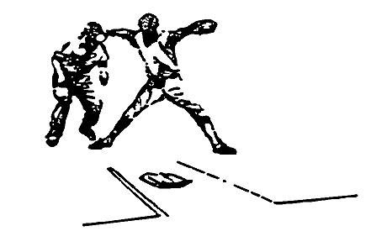

UMPIRE INTERFERENCE
ONLY TWO WAYS
INTERFERENCE WITH CATCHER'S THROW – 5.09(b)
HIT BY BATTED BALL BEFORE PASSING A FIELDER – 5.09(f)
NO UMPIRE INTERFERENCE
BEING HIT BY A THROWN BALL
BEING HIT BY FIELDER
BEING HIT BY A RUNNER
Notes:
0:02 total 1:04
There are only "TWO" ways an umpire can interfere on a baseball or softball
field.
(1) Interfere with the catchers throw on a steal attempt.
Note: Catcher must make the throw on the steal attempt in order for you
to call this.
⇒ Only the plate umpire may interfere with the catcher and only on a cleanly caught ball or a pitched ball that doesn’t cause the catcher to move from his/her position. If the catcher errs on the ball, the umpire will be considered part of the field, and no interference results.
(2) Hit by batted ball before passing a fielder.
Note: On a 60' diamond this should never happen because we are
always behind the defense and on a 90' diamond this can and does happen.
Be alert…….you can get hurt badly.

Slide 21
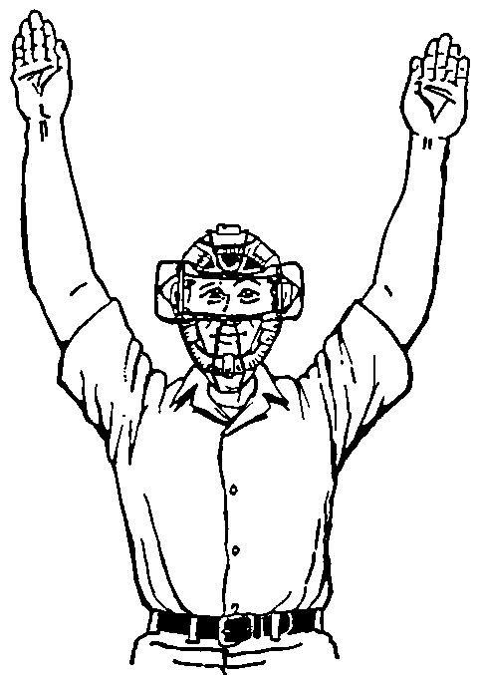
SPECTATOR INTERFERENCE
What is it?
A spectator reaches out of the stands into the playing area, and touches a live ball.
What do you do?
Call “TIME”.
Give signal (Grasp LEFT wrist with RIGHT hand with hands above head).
Impose penalties that will negate the actions of the spectator.
Notes:
0:02 total 1:40

Slide 22
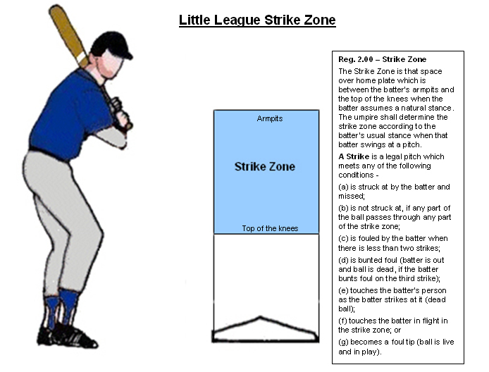
STRIKE ZONE - 2.00
Notes:
0:02 total 1:31
The strike zone is BIG. Nothing is more boring than a game full of walks.
Consistancy is critical in calling a good game. Whatever is a strike in the first inning needs to be a strike at the end of the game.
We all miss pitches. Do not try to do any makeup calls.

Slide 23
6.05 A Batter Is Out When…
A | A fair or foul fly ball (other than a fair tip) is legally caught by a fielder
B | Third strike…
C | Bunting foul on a third strike
D | An infield fly is declared
E | That batter attempts to hit a 3rd strike and is touched by the ball
F | A fair ball touches said batter before touching a fielder
G | After hitting or bunting a fair ball, the bat hits the ball a 2nd time…
H | After hitting or bunting a foul ball, the batter-runner intentionally deflects…
I | After hitting a fair ball, the batter-runner or 1st base is tagged before said batter runner touches first base
J | Failure to run in the runner's lane and interferes with the 1st baseman
K | Intentionally dropped fly ball
L | A preceding runner shall, intentionally interfere with a fielder attempting to catch a thrown ball or to throw a ball in an attempt to make a play
M | Jun., Sen., B.L.; a pitch touches a runner stealing home in the strike zone
Notes:
0:05 total 1:49

Slide 24
6.06 A Batter Is Out For Illegal Action When…
A Hitting the with one or both feet entirely outside the batter’s box
Stepping from one batter’s box to the other while the pitcher is ready to pitch
Interfering the the catcher’s fielding or throwing by:
  Stepping out of the batter’s box
  Making any other movement that hinder the catcher’s actions at home plate
  Failing to make a reasonable effort to vacate a congested area when there is a throw to home plate and there is time for the batter to move away
The batter enters the batter’s box with one or both feet on the ground with an illegal bat.

Slide 25
6.08 (c) Catcher Interference
The catcher or any fielder interferes the batter.
No Interference When:
Batter reaches first base AND all other runners advance at least one base.
Key Elements:
Allow the play to continue
Call TIME and award the batter 1st
Runners not attempting to steal or not forced to advance remain on the base they occupied at the time of the interference.
Notes:
0:03 total 1:43

Slide 26
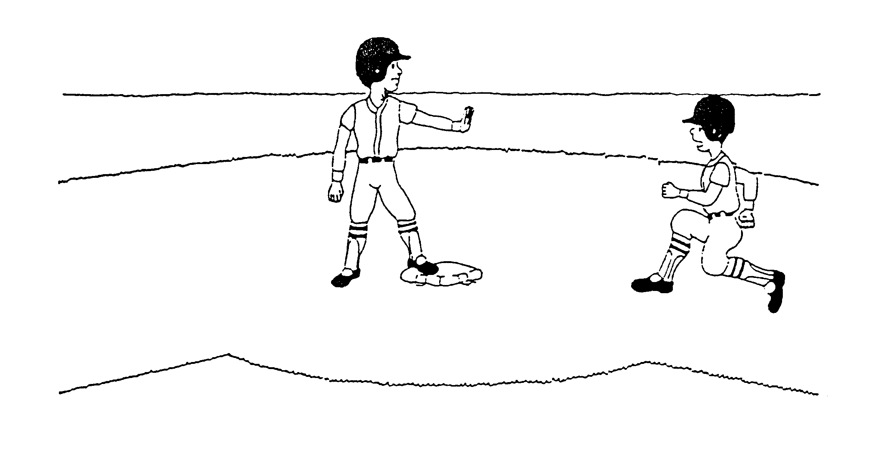
7.03 TWO RUNNERS ON THE SAME BASE
FORCE NOT IN EFFECT: Two runners may not occupy the same base, but if, while the ball is alive, two runners are touching the same base, the proceeding runner is entitled to the base, and the following runner shall be out when tagged.
FORCE IN EFFECT If the play is the result of a force play…the lead runner would be out.
Notes:
0:03 total 1:52
Make sure they know who is out.
The following runner (the 2nd runner) is out.

Slide 27
7.05 (f), (g) and (h) - Base Awards
7.05(f) Two Bases – if fair ball bounces goes into a stand or a bench or over or through a field fence or backstop. The ball is dead.
7.05 (h) One Base - when a ball pitched to the batter or thrown by the pitcher from his position on the pitcher’s plate to base to catch a runner, goes in a stand or a bench or over or through a field fence or backstop. The ball is dead.
7.05 (g) Two Bases – when a thrown ball goes into the stands or bench or over under a fence… The ball is dead.
  When it is the first play by and infielder, the Umpire shall be governed by the of the runners at the time the ball was pitched.
  In all other case the Umpire shall be governed by the position of the runners at the time the wild throw was made.

Slide 28
Two Base Awards From
Time Of Pitch
THROWN BALL INTO DEAD TERRITORY ON FIRST PLAY BY AN INFIELDER
7.05g
FIELDER DEFLECTS WILD
PITCH INTO DEAD TERRITORY
WHILE RETRIEVING IT
7.05f
FAIR BATTED BALL
IS DEFLECTED INTO
DEAD TERRITORY ON
FOUL GROUND
FAIR BATTED BALL BOUNCES OVER OR FLIES THROUGH FENCE
Notes:
0:02 total 1:41
Go over the two base awards for TIME OF PITCH:
1. Thrown ball into dead ball territory on 1st play by infielder
2. Fielder deflects wild pitch into dead ball territory
3. Fielder deflects batted ball into dead ball territory
4. Fair batted ball bounces over or flies through fence

Slide 29
Two Base Awards From
Time Of Throw
THROWN BALL INTO
DEAD TERRITORY ON
SUBSEQUENT (NOT FIRST)
PLAY BY AN INFIELDER
THROWN BALL INTO
DEAD TERRITORY BY
AN OUTFIELDER
ANY RELAY
THROWN INTO
DEAD TERRITORY
BY ANY FIELDER
THROWN BALL INTO DEAD TERRITORY BY ANY FIELDER IF BATTER-RUNNER AND ALL RUNNERS HAVE ADVANCED ONE BASE EACH
THROWN BY A
FIELDER NOT
PRECEDED BY A
BATTED BALL
E.G. CATCHERS
PICK-OFF THROW
OR THROW TO
PREVENT STEAL
Notes:
0:03 total 1:44
Two base awards at 'TIME OF THROW":
Time of throw means when the ball was released out of the hand, not when it
passed the defensive player, not when it when out of play, but when the ball
was released.
1. Subsequent (not first) play by an infielder
2. Thrown ball by an outfielder goes into dead ball territory,
not a batted ball, but thrown by a fielder into dead ball territory, i.e.
catcher's throw on pick-off or to prevent a steal.
3. Relay throw by anyone.
4. Any fielder throwing ball into dead ball territory if all runners including
batter-runner have advanced at least one base
5. THROWN BY A FIELDER NOT PRECEDED BY A BATTED BALL E.G. CATCHERS PICK-OFF THROW OR THROW TO PREVENT STEAL

Slide 30
7.06 Obstruction – TYPE A
When Obstruction occurs, the Umpire shall call or signal “OBSTRUCTION”
If a play is being made on an obstructed runner, or if the batter-runner is obstructed before touching 1st base, the ball is DEAD, and all runners shall advance to the bases they would have reached had there been no obstruction.
The obstructed runner shall be awarded at least one base beyond the last base legally touched.
Notes:
0:03 total 1:24

Slide 31
7.06 Obstruction – TYPE B
When Obstruction occurs, the Umpire shall call or signal “OBSTRUCTION”
If no play is being made on the obstructed runner, the play shall proceed until no further action is possible. The umpire shall then call “time” and impose such penalties that will nullify the obstruction.
When the ball is not dead and obstructed runner advances beyond the base which, in the umpire's judgment, the runner would have been awarded, they do so at their own risk.
Notes:
0:02 total 1:47

Slide 32
The Difference Between Interference & Obstruction
The fielder always has the right to field the ball. If a runner interferes with that fielder, that is INTERFERENCE.
If a fielder does not have possession of the ball, that fielder shall not hinder the runner. If this happens, that is OBSTRUCTION.
INTERFERENCE the ball is DEAD (except for catchers, batters, or umpire’s interference).
OBSTRUCTION the ball is dead only if there is a play being made on the obstructed runner.
Notes:
0:02 total 1:29
The interference does not have to be physical contact.
A runner dances in front of the fielder who is trying to field the ball COULD be ruled out if, in your judgment, he hindered that fielder.

Slide 33
7.08 (a)1 BASELINE
A runner is out if he/she is trying to avoid a tag, and runs more than 3 feet from the baseline
NOTE: The baseline is not always a direct line between bases.
2nd
1st
Notes:
0:01 total 1:56
DISCUSS HOW A RUNNER CREATES THEIR BASELINE
DISCUSS RUN-DOWNS

Slide 34
7.08 (a)3 SLIDING
Runner is out if he/she does not slide or attempt to get around a fielder who has the ball and is awaiting to make the tag.
Runner is out if he/she slides headfirst while advancing.
NOTE:
There is NO “MUST SLIDE” rule.
The fielder must have the ball in his POSSESSION; AND
The fielder must be WAITING to make the tag;
Notes:
0:02 total 1:55
7.08(a) A runner is out when:
(3) Runner does not slide or attempt to get around a fielder who has the ball and is awaiting to make the tag;
Comments:
This is the most misunderstood rule in the book. It is easily broken down as follows:
1) There is NO “MUST SLIDE” rule and no League may create one.
2) The fielder must have the ball in his possession; AND
3) The fielder must be WAITING to make the tag; IF BOTH of those two criteria are satisfied, then the runner must EITHER: (1) Slide; OR (2) ATTEMPT to get around the fielder.
4) The rule says “attempt to get around”. Contact may occur with no penalty assessed.

Slide 35
7.08 (a)4 Runner passess
another Runner
If a runner passes another runner, the SPEEDY runner is out.
Make sure that you are clear on which runner is declared out.
Notes:
0:01 total 1:53

Slide 36
7.13 Lead Offs
7.13– Little League (Majors) and Minor League Baseball: When a pitcher is in contact with the pitcher’s plate and in possession of the ball and the catcher is in the catcher’s box ready to receive delivery of the ball, base runners shall not leave their bases until the ball has been delivered and has reached the batter.
The violation by one base runner shall affect all other base runners -
(a) when a base runner leaves the base before the pitched ball has reached the batter and the batter does not hit the ball, the runner is permitted to continue. If a play is made on the runner and the runner is out, the out stands. If said runner reaches safely the base to which the runner is advancing, that runner must be returned to the base occupied before the pitch was made, and no out results;
Notes:
0:03 total :16
PENALTY:
“TIME”
BATTER IS OUT
RUNNERS RETURN TO ORIGINAL BASES

Slide 37
7.13 Lead Offs - cont’d…
(b) When a base runner leaves the base before the pitched ball has reached the batter and the batter hits the ball, the base runner or runners are permitted to continue. If a play is made and the runner or runners are put out, the out or outs will stand.
If not put out, the runner or runners must return to the original base or bases or to the unoccupied base nearest the
one that was left; In no event shall the batter advance beyond first base on a single or error, second base on a double or third base on a triple. The umpire-in-chief shall determine the base value of the hit ball.
c) When any base runner leaves the base before the pitched ball has reached the batter and the batter bunts or hits a ball
within the infield, or advances on an uncaught third strike, no run shall be allowed to score. If three runners were on the bases and the batter reaches first base safely, each runner shall advance to the base beyond the one they occupied at the start of the play except the runner who occupied third base, that runner shall be removed from the base without a run being scored.
Notes:
0:03 total 0:19
PENALTY:
“TIME”
BATTER IS OUT
RUNNERS RETURN TO ORIGINAL BASES

Slide 38
Lead Offs - 7.13 cont’d…
EXAMPLES:
1. Runner on first leaves too soon, batter reaches first safely, runner goes to second.
2. Runner on second leaves too soon, batter reaches first safely, runner returns to second.
3. Runner on third leaves too soon, batter reaches first safely, runner returns to third.
4. Runner on first leaves too soon, batter hits clean double, runner goes to third only.
5. Runner on second leaves too soon, batter hits clean double, runner goes to third only.
6. Runner on third leaves too soon, batter hits clean double, runner returns to third.
7. All runners on base will be allowed to score when the batter hits a clean triple or home run, regardless of whether any runner left too soon.
8. Runners on first and second, either leaves too soon, batter reaches first safely, runners go to second and third.
9. Runners on first and second, either leaves too soon, batter hits clean double, runner on first goes to third, runner on second scores.
10. Runners on first and third, either leaves too soon, batter reaches first safely, runner on first goes to second, runner on third remains there.
Notes:
0:03 total 0:22
PENALTY:
“TIME”
BATTER IS OUT
RUNNERS RETURN TO ORIGINAL BASES

Slide 39
QUESTIONS AND ANSWERS
Dundas Little League 2023

